Slide 1
Describing distribution of data
If asked to write a description of a set of scores, we should comment on:
The location of the scores
How spread out the scores are
The ‘shape’ of the distribution’
Anything else relevant
Location: The mean and the median gives information about location.
Spread: The range gives information about spread.
Shape: Symmetry, gaps, clustering, more dense/less dense areas, outliers, modality (does the data have one mode or is it bimodal) gives information about the shape of a distribution.

Slide 2
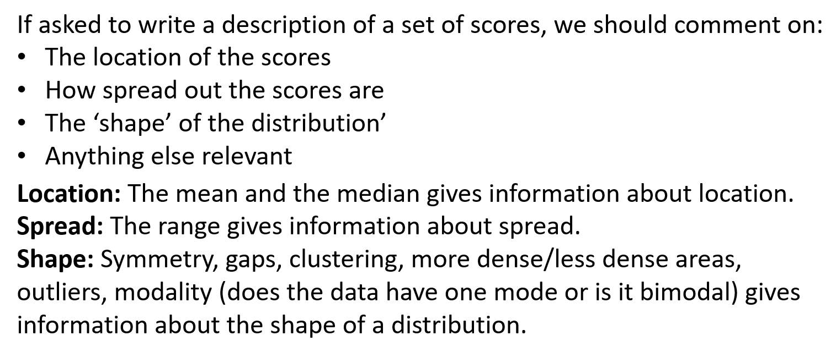
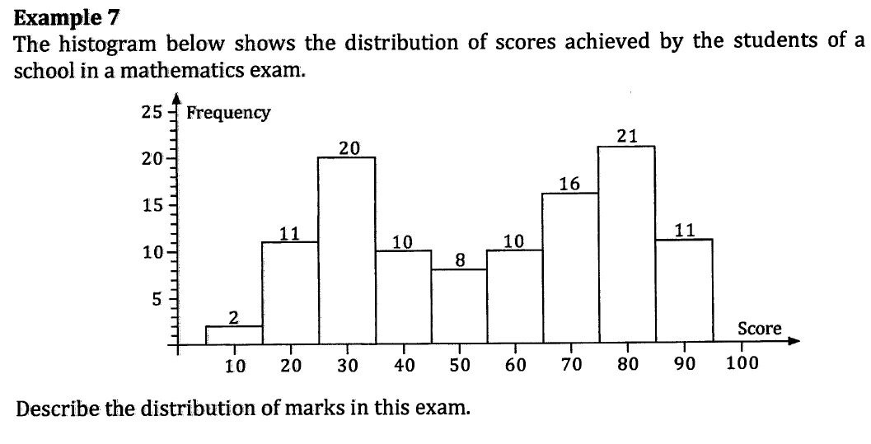
Describing distribution of data
Now do Exercise 2C
The histogram shows the exam scores achieved by 109 students.
The estimated mean is 55.3 and the median class is between 55 and 65.
The scores were well spread out with an estimated range of
95-5 = 90.
The scores were reasonably symmetrically spread about a mid point of about 55. The distribution was bimodal with a high amount of scores around 30 and again around 80.
About a third of the students scored less than 35 and about a third scored more than 75.
Describe what it is you are describing.
Describe the location.
Describe the spread.
Describe the shape.
Anything else you notice.

